Slide 1
Group 4’s autonomous search and destroy Initial presentation
Alejandro Garcia
David Ozoude
Lora Milam

Slide 2
overview
Problem Statement
Major Hardware Components
Software Flowchart
Roadmap
Budget

Slide 3
Problem statement
Create an autonomous vehicle that follows a track of 1” reflective tape and stops at three points, indicated by 1” by 2” rectangle of bright red tape, along the track to fire a projectile at a target either to the right or left of the track.
The targets will have a white LED flashing at a frequency of approximately 20 Hz. They will be 12 inches in diameter with the bull’s eye placed 1.5 feet off the floor.
The three targets will be placed at distances of 2, 4, and 6 feet from the track.
After the 3rd target, it will return to the start of the track which will be indicated by a 1” by 2” rectangle of green tape.

Slide 4
Major Hardware Components
Basys 3 board
Optical Sensors
Power Supply
Firing Mechanism
Rover
Servos

Slide 5
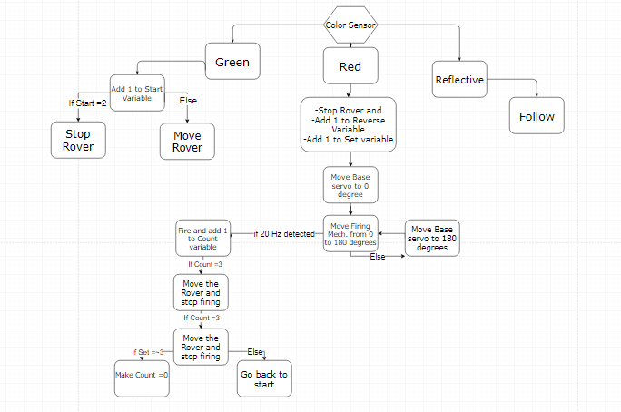
software flowchart

Slide 6
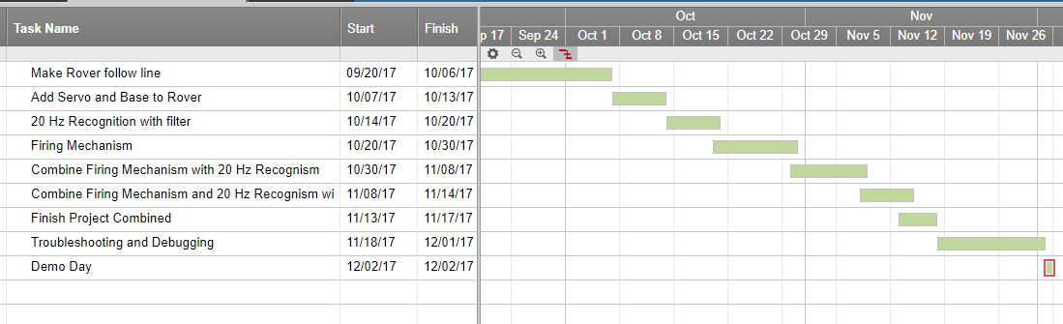
Roadmap

Slide 7
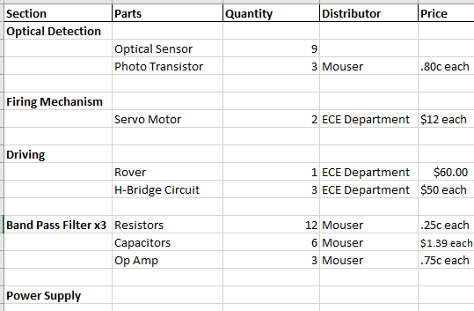
budget

Slide 8
recap
Problem Statement
Major Hardware Components
Software Flowchart
Roadmap
Budget

Slide 9
Works cited
https://www.draw.io/
https://app.smartsheet.com/b/home
https://ttu.blackboard.com/webapps/blackboard/execute/content/file?cmd=view&content_id=_3001780_1&course_id=_47616_1

